Slide 1
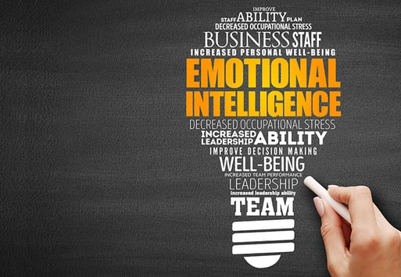
Emotional Intelligence for Financial Planners
Presented by
Kira B Copperman, LMSW, BCC

Slide 2
Self-Awareness Competencies
People with Emotional Self-Awareness
1
2
3
4
5
Recognize how emotions affect them at work
Know what they value at work
Understand implications of their own emotions
Are aware of their triggers
Are aware of their own feelings

Slide 3






Ways to Improve Self-Awareness
What will you do?
Be open to feedback from EVERYONE
Put mistakes into perspective
Pay attention to your own non-verbal communication
3
Be aware of your triggers
Know what you need to maintain motivation
Recognize your stress level
3

Slide 4





Self-Management Competencies
People with this competency
Stay composed and positive even when challenged
Respond calmly to others even when under pressure
Are adaptable to changes
Stay open and transparent
Keep themselves motivated and resilient

Slide 5
Ways to Improve Self-Management
What will you do?
01
Know what you need to maintain composure
02
Pause….think…react
03
Build your resilience
04
Reframe thoughts
05
Shift into neutral

Slide 6




Social Awareness/Empathy
People with this competency
Take time to understand other people
Are able to read body language and other nonverbal cues
Actively listen to clients
Are in tune with group emotions and complex relationships

Slide 7
Ways to Improve Social Awareness
What will you do?
1
CYA – Check Your Assumptions
Don’t assume you know what they are thinking – ask them
2
Try not to “should” on your clients
Are you focused on their goals or on what you think their goals “should” be
3
Pay attention to what they want from their relationship with you
Are they focused on the bottom line, facts and data, do they want to be friends, do they want to talk about options, ideas, etc?
4
TOPS – Frequently put yourself in “the other person’s shoes”

Slide 8

Relationship Management Competencies
Sense others’ style differences and adjust accordingly
Manage conflict effectively
Provide support
Focus on the client and their priorities
People with this competency

Slide 9





Emotionally Intelligent Conversation Tips
Listen first
AcknowledgeValidate
Ask open ended questions
Check your assumptions CYA
Diffuse emotions or take a break
Actively show you’re listening
“It sounds like you are frustrated you aren’t reaching your financial goals as quickly as you expected”
“What can I clarify for you? What is most concerning to you? What change do you think would be helpful to you?
Let me make sure I am hearing you correctly. You want to….. by this date?
“I think we need to take a break and regroup later”

Slide 10
Listening Traps
Tuning Out
Not paying attention to the client due to disinterest in the speaker or subject. Thinking about other things or multitasking.
Rehearsing
Concentrating on what to say or do next rather than focusing on the client’s message. Planning the next steps before the client has finished.
Detachment
Remaining emotionally detached from the client, concerned with content only and not the feelings behind it. Only half listening or not interacting, thereby missing the message’s underlying meaning.
Judging
Having a different opinion that causes the listener to block out new ideas and information. Over analyzing the client’s underlying meaning causing you to miss the point.
Controlling the Conversation
Failure to allow the client to talk at his or her own pace. Constantly interrupting with comments or questions.

Slide 11
Difficult Conversation Traps
The Information Trap
Trying to change someone’s mind by teaching or informing them without getting an understanding of what they are concerned about
The Lecture Trap
Talking at the client instead of with them.
The Labeling Trap
Generalizing and labeling your clients ie, irrational, unrealistic, out of touch, etc. This won’t allow you to listen openly to their concerns because you’ve already decided how the conversation with go
The Blaming Trap
Telling the clients what they are doing wrong or what they need to differently in a way that makes them feel blamed. This will put them on the defensive
Escalation Trap
You get triggered by what the client says, and your emotions start to escalate with them. This never ends well.

Slide 12
Ways to Improve Relationship Management
What will you do?
Treat people the way they want to be treated
Choose the appropriate communication approach
Recognize and react to other people’s emotions
Show empathy
Avoid conversation traps

Slide 13

Thanks for your participation!
Kira B Copperman, LMSW, BCC
KBC Consulting
917-363-0295

